Slide 1
Project: Trade & Ahead
Julian Patton - BATCH: PGP-DSBA-UTA-APR22-A2
11/26/2022

Slide 2
Contents / Agenda
Executive Summary
Business Problem Overview and Solution Approach
EDA Results
Data Preprocessing
K-Means Clustering
Hierarchical Clustering
Appendix

Slide 3
Executive Summary
Oil and Gas Exploration & Production has the largest count in the GICS Sub Industry.
REITs and Industrial Conglomerates have the same count in the GICS Sub Industry.
Electric Utilities, Internet Software & Services, Healthcare Equipment, and Banks also have a significant count within the GICS Sub Industry Dataset.
Industrials and Financials has the largest count in the GICS Sector.
Consumer Discretionary and Health Care have the same count in the GICS Sector.
Telecommunications has the lowest count in the GICS Sector.

Slide 4
Executive Summary (Con’t)
In K-means clustering:
Cluster 2 was significantly larger than the other clusters after graphing Silhouette Visualizer.
  Cluster 7 has the highest current price.
  Clusters 0 and 3 appear to be the most volatile.
  Cluster 3 has the highest ROE.
  Cluster 1 has the highest Cash Ratio.
  Cluster 2 has a large set of outliers for the Net Cash flow. Cluster 5 has the best Net Cash Flow.
  Cluster 3 has the lowest Earnings per share.
  Cluster 7 has the highest P/E Ratio
  Cluster 8 has the highest Estimated Shares Outstanding.
  Cluster 8 has the highest Net Income.

Slide 5
Executive Summary (Con’t)
In K-means clustering:
Cluster 2 was significantly larger than the other clusters after graphing Silhouette Visualizer.
  Cluster 7 has the highest current price.
  Clusters 0 and 3 appear to be the most volatile.
  Cluster 3 has the highest ROE.
  Cluster 1 has the highest Cash Ratio.
  Cluster 2 has a large set of outliers for the Net Cash flow. Cluster 5 has the best Net Cash Flow.
  Cluster 3 has the lowest Earnings per share.
  Cluster 7 has the highest P/E Ratio
  Cluster 8 has the highest Estimated Shares Outstanding.
  Cluster 8 has the highest Net Income.

Slide 6
Executive Summary (Con’t)
In hierarchical clustering:
Cluster 2 was significantly larger than the other clusters after graphing Silhouette Visualizer.
  Cluster 0 has the highest Current Price.
  Cluster 0 has the highest Average Price Change but Cluster 2 has larger outliers.
  Cluster 0 has the highest Average Volatility but Cluster 2 has larger outliers.
  Cluster 2 has the highest ROE.
  Cluster 1 has the highest Net Cash Flow.
  Cluster 1 has the highest P/E Ratio.
  Cluster 1 has the highest Estimated Shares Outstanding.
  Cluster 2 has the highest P/B ratio.

Slide 7
Data Description
There are 340 Stock Ticker Entries and 15 columns in the dataset.
Within the columns there are a series of objects, float and int values.

Slide 8
Business Problem Overview
The stock market has consistently proven to be a good place to invest in and save for the future. There are a lot of compelling reasons to invest in stocks. It can help in fighting inflation, create wealth, and also provides some tax benefits. Good steady returns on investments over a long period of time can also grow a lot more than seems possible. Also, thanks to the power of compound interest, the earlier one starts investing, the larger the corpus one can have for retirement. Overall, investing in stocks can help meet life's financial aspirations.
It is important to maintain a diversified portfolio when investing in stocks in order to maximise earnings under any market condition. Having a diversified portfolio tends to yield higher returns and face lower risk by tempering potential losses when the market is down. It is often easy to get lost in a sea of financial metrics to analyze while determining the worth of a stock, and doing the same for a multitude of stocks to identify the right picks for an individual can be a tedious task. By doing a cluster analysis, one can identify stocks that exhibit similar characteristics and ones which exhibit minimum correlation. This will help investors better analyze stocks across different market segments and help protect against risks that could make the portfolio vulnerable to losses.

Slide 9
Solution Approach
Trade&Ahead is a financial consultancy firm who provide their customers with personalized investment strategies. They have hired you as a Data Scientist and provided you with data comprising stock price and some financial indicators for a few companies listed under the New York Stock Exchange. They have assigned you the tasks of analyzing the data, grouping the stocks based on the attributes provided, and sharing insights about the characteristics of each group.

Slide 10
Data Dictionary
Ticker Symbol: An abbreviation used to uniquely identify publicly traded shares of a particular stock on a particular stock market
Company: Name of the company
GICS Sector: The specific economic sector assigned to a company by the Global Industry Classification Standard (GICS) that best defines its business operations
GICS Sub Industry: The specific sub-industry group assigned to a company by the Global Industry Classification Standard (GICS) that best defines its business operations
Current Price: Current stock price in dollars
Price Change: Percentage change in the stock price in 13 weeks
Volatility: Standard deviation of the stock price over the past 13 weeks
ROE: A measure of financial performance calculated by dividing net income by shareholders' equity (shareholders' equity is equal to a company's assets minus its debt)
Cash Ratio: The ratio of a company's total reserves of cash and cash equivalents to its total current liabilities

Slide 11
Data Dictionary (Con’t)
Net Cash Flow: The difference between a company's cash inflows and outflows (in dollars)
Net Income: Revenues minus expenses, interest, and taxes (in dollars)
Earnings Per Share: Company's net profit divided by the number of common shares it has outstanding (in dollars)
Estimated Shares Outstanding: Company's stock currently held by all its shareholders
P/E Ratio: Ratio of the company's current stock price to the earnings per share
P/B Ratio: Ratio of the company's stock price per share by its book value per share (book value of a company is the net difference between that company's total assets and total liabilities)

Slide 12
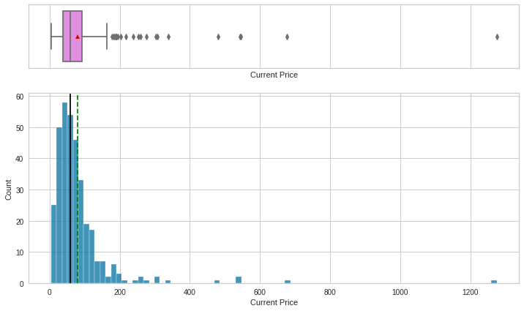
Univariate Analysis: Current Price
Average Current Price: 80.862345
Median Current Price: 59.705
Max Current Price: 1274.949951
Min Current Price: 4.5
The data appears to be right skewed distributed. There are several outliers within Current Price.
Link to Appendix slide on data background check

Slide 13
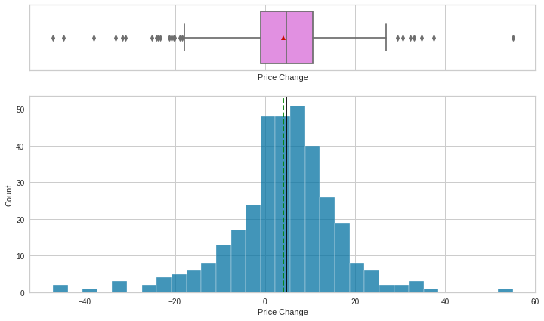
Univariate Analysis: Price Change
Average Price Change: 4.078194
Median Price Change: 4.819505
Max Price Change: 55.051683
Min Price Change: -47.129693
The data appears to be more evenly distributed but skewed left. There are also outliers in the Price Change.
Link to Appendix slide on data background check

Slide 14
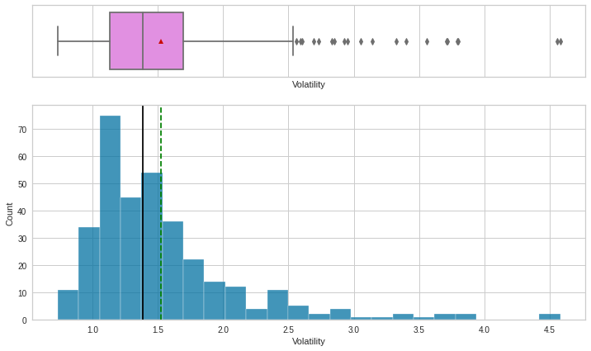
Univariate Analysis: Volatility
Average Volatility: 1.525976
Median Volatility: 1.385593
Max Volatility: 4.580042
Min Volatility: 0.733163
The data appears to be slightly right skewed. There are also outliers in the Volatility.
Link to Appendix slide on data background check

Slide 15
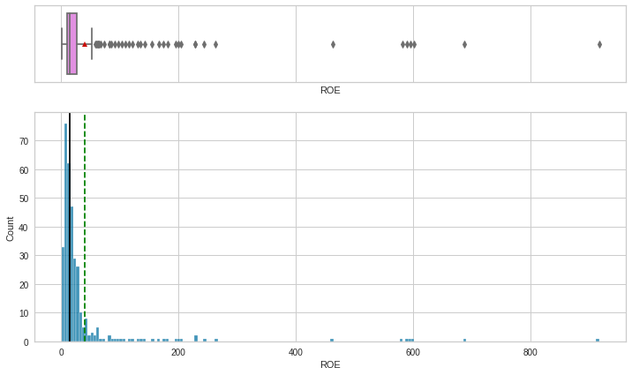
Univariate Analysis: ROE
Average ROE: 39.597059
Median ROE: 15.0
Max ROE: 917.0
Min ROE: 1.0
The data appears to be right skewed. There are also outliers in the ROE.
Link to Appendix slide on data background check

Slide 16
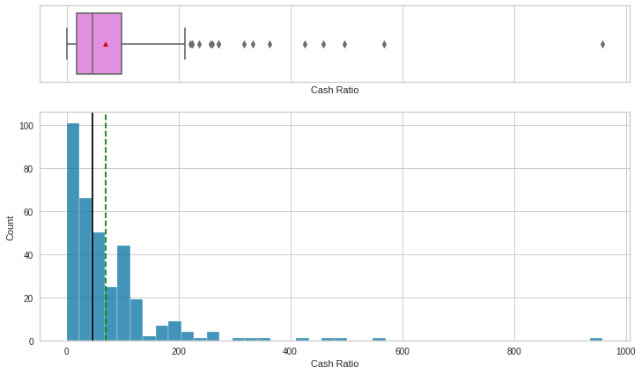
Univariate Analysis: Cash Ratio
Average Cash Ratio: 70.023529
Median Cash Ratio: 47.0
Max Cash Ratio: 958.0
Min Cash Ratio: 0.0
The data appears to be right skewed. There are also outliers in the Cash Ratio.
Link to Appendix slide on data background check

Slide 17
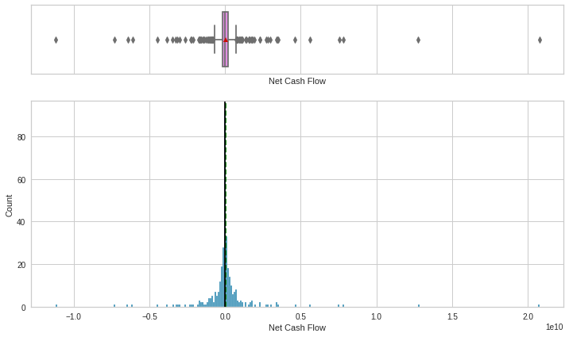
Univariate Analysis: Net Cash Flow
Average Net Cash Flow: 55537620.588235
Median Net Cash Flow: 2098000.0
Max Net Cash Flow: 20764000000.0
Min Net Cash Flow: -11208000000.0
The data appears to be right skewed. There are also outliers in the net cash flow.
Link to Appendix slide on data background check

Slide 18
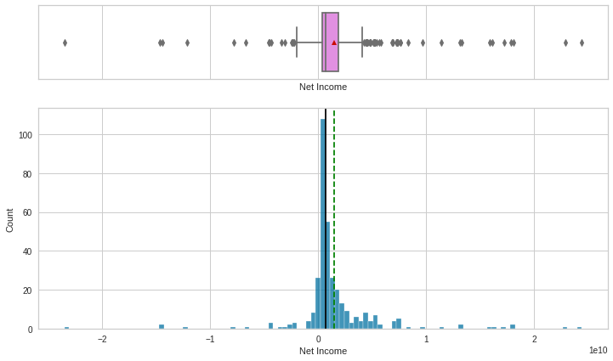
Univariate Analysis: Net Income
Average Net Income: 1494384602.941176
Median Net Income: 707336000.0
Max Net Income: 24442000000.0
Min Net Income: -23528000000.0
The data appears to be left skewed. There are also outliers in the net income.
Link to Appendix slide on data background check

Slide 19
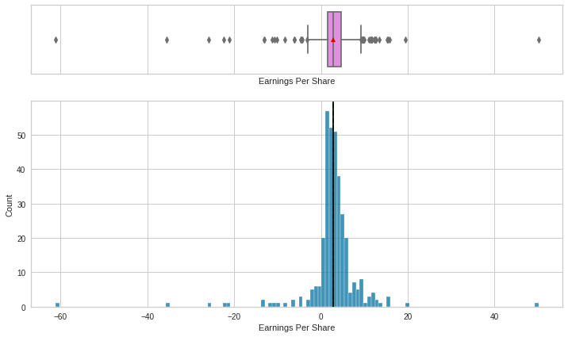
Univariate Analysis: Earnings Per Share
Average Earnings Per Share: 2.776662
Median Earnings Per Share: 2.895
Max Earnings Per Share: 50.09
Min Earnings Per Share: -61.2
The data appears to be more evenly distributed (slightly right skewed). There are also outliers in the earnings per share.
Link to Appendix slide on data background check

Slide 20
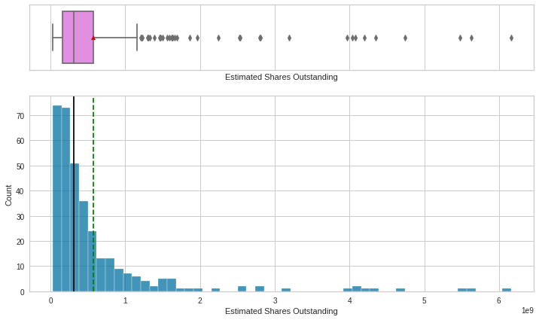
Univariate Analysis: Estimated Shares Outstanding
Average Est. Shares Outstanding: 577028337.75403
Median Est. Shares Outstanding:
309675137.8
Max Est. Shares Outstanding:
6159292035.0
Min Est. Shares Outstanding:
-47.129693
The data appears to be more right skewed. There are also outliers in the estimated shares outstanding.
Link to Appendix slide on data background check

Slide 21
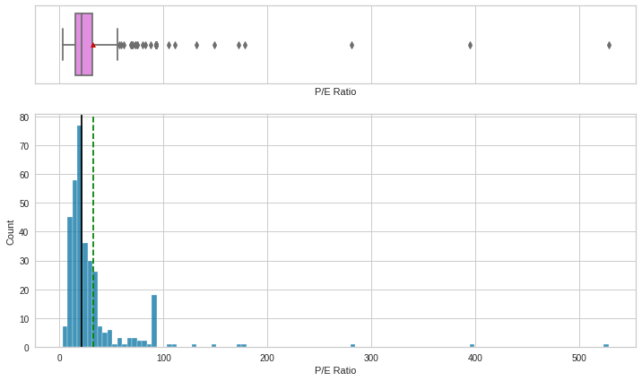
Univariate Analysis: P/E Ratio
Average P/E Ratio: 32.612563
Median P/E Ratio: 20.819876
Max P/E Ratio: 528.039074
Min P/E Ratio: 2.935451
The data appears to be right skewed. There are also outliers in the P/E Ratio.
Link to Appendix slide on data background check

Slide 22
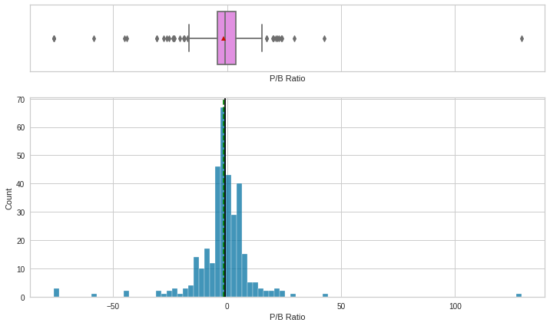
Univariate Analysis: P/B Ratio
Average P/B Ratio: 4.078194
Median P/B Ratio: 4.819505
Max P/B Ratio: 55.051683
Min P/B Ratio: -47.129693
The data appears to be more evenly distributed (Slightly left skewed). There are also outliers in the P/B Ratio.
Link to Appendix slide on data background check

Slide 23
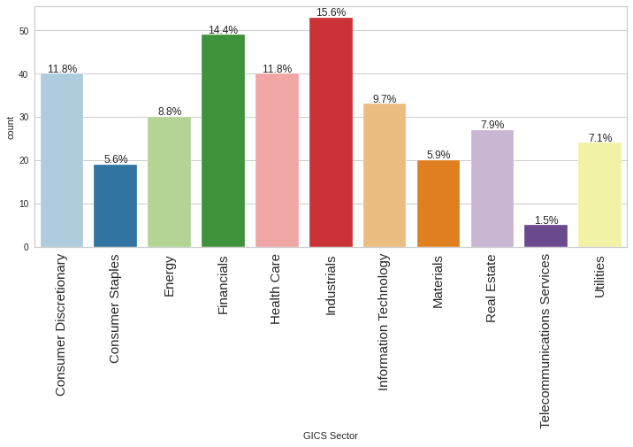
Univariate Analysis: GICS Sector
Industrials and Financials has the largest count in the GICS Sector.
Consumer Discretionary and Health Care have the same count in the GICS Sector.
Telecommunications has the lowest count in the GICS Sector.
Link to Appendix slide on data background check

Slide 24
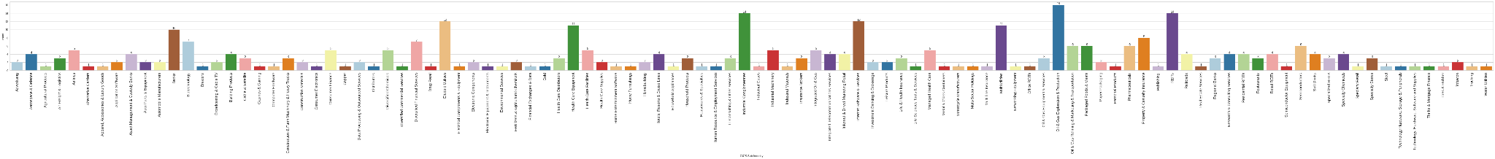
Univariate Analysis: GICS Sub Industry
Oil and Gas Exploration & Production has the largest count in the GICS Sub Industry.
REITs and Industrial Conglomerates have the same count in the GICS Sub Industry.
Electric Utilities, Internet Software & Services, Healthcare Equipment, and Banks also have a significant count within the GICS Sub Industry Dataset.
Link to Appendix slide on data background check

Slide 25
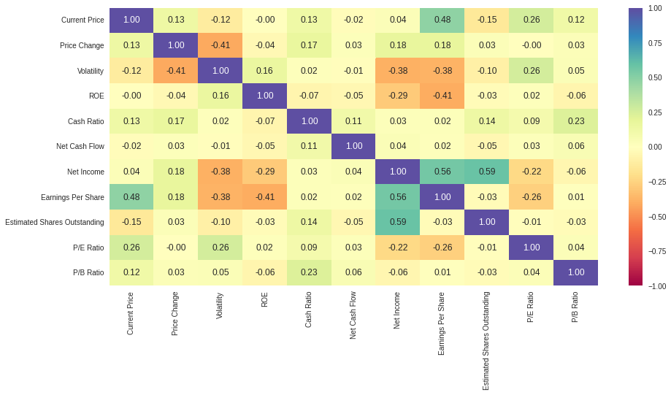
Bivariate Analysis: Heat Map
Correlation between Current Price and Earnings Per Share.
Low correlation between Price Change and Volatility.
High correlation between Net Income and Earnings Per Share.
High Correlation between Estimated Shares Outstanding and Net Income.
Link to Appendix slide on data background check

Slide 26
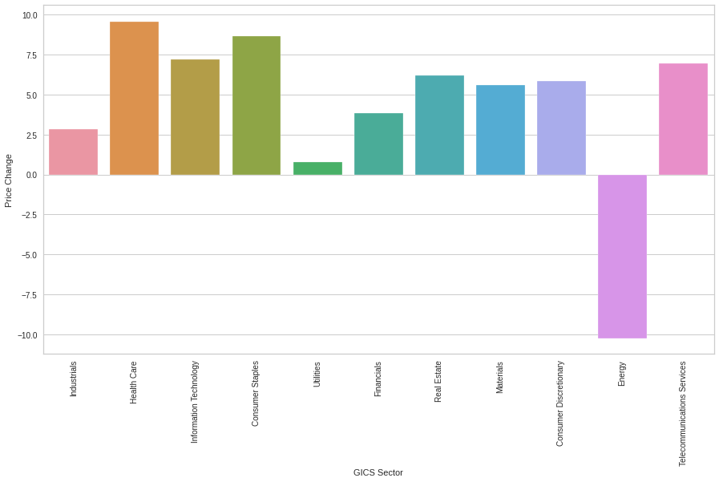
Bivariate Analysis: GICS Sector vs. Price Change
There is an extremely low price change for Energy in the GICS Sector.
Health Care and Consumer Staples have the highest price change in the GICS Sector.
Utilities has the least changed price change.
Information Technology and Telecommunications Services appears to have a similar price change.
Real Estate has a slightly higher price change compared to Materials and Consumer Discretionaries.
Link to Appendix slide on data background check

Slide 27
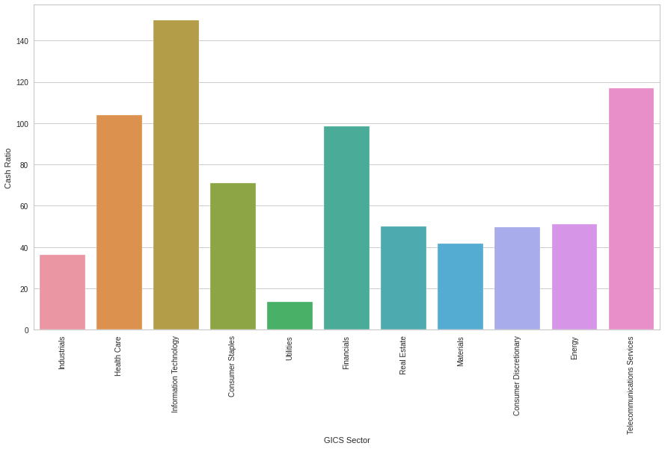
Bivariate Analysis: GICS Sector vs. Cash Ratio
Information Technology and Telecommunication Services have the highest cash ratio in the GICS Sector.
Health Care has a slightly higher cash ratio compared to Financials.
Utilities has the lowest cash ratio in the GICS Sector.
Energy has a slightly higher cash ratio compared to Consumer Discretionaries and Real Estate.
Link to Appendix slide on data background check

Slide 28
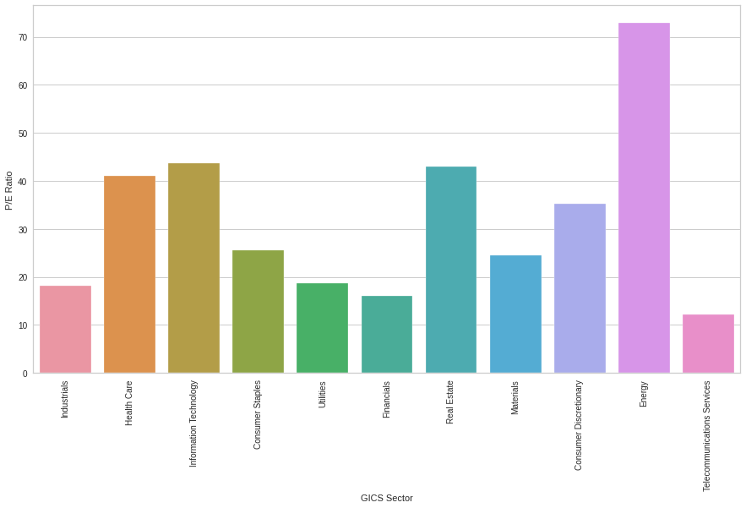
Bivariate Analysis: GICS Sector vs. P/E Ratio
Energy has the highest P/E Ratio in the GICS Sector.
Information Technology has the 2nd highest P/E ratio in the GICS Sector.
Telecommunication Services has the lowest P/E Ratio.
Link to Appendix slide on data background check

Slide 29
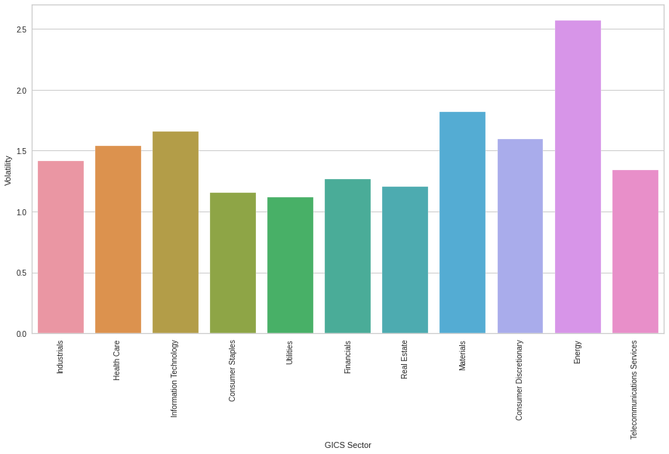
Bivariate Analysis: GICS Sector vs. Volatility
Energy has the the highest volatility in the GICS Sector.
Materials has the 2nd highest Volatility in the GICS Sector.
Information Technology is slightly more volatile than Consumer discretionaries.
Health care is slightly more volatile than Industrials.
Financials is more volatile than Real Estate.
Link to Appendix slide on data background check

Slide 30
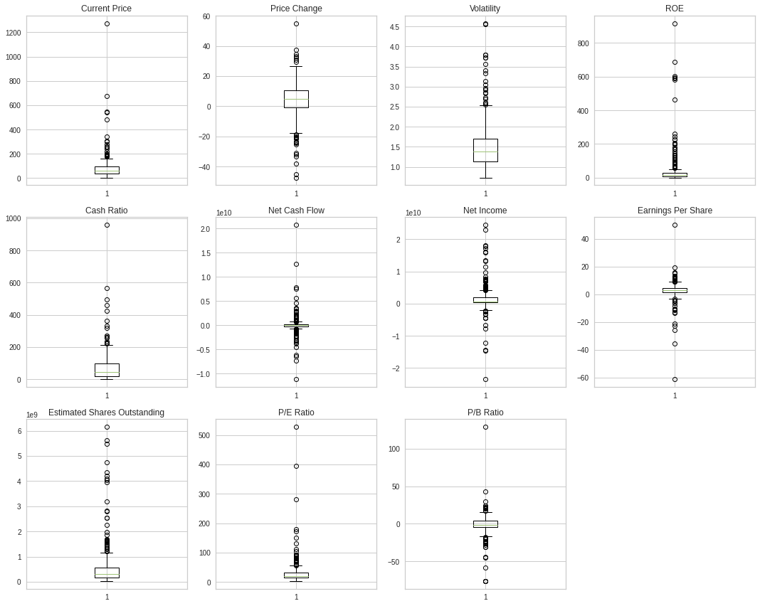
Data Preprocessing: Outlier Check (Numeric Columns)
We scaled the data before proceeding to Clustering, from the numeric columns.
Once we were able to start with K-means clustering.

Slide 31
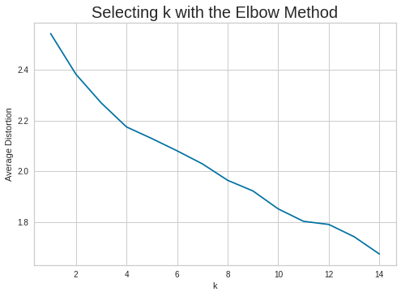
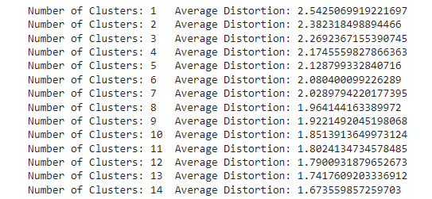
K-Means Clustering: Checking Elbow Plot
The appropriate value of k from the elbow curve seems to be 4 or 10.5

Slide 32
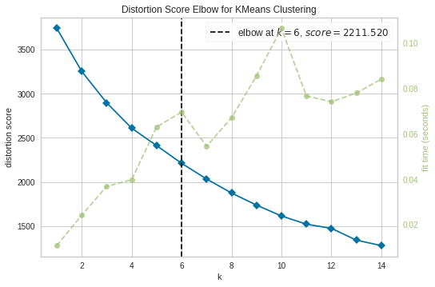
K-Means Clustering: Checking Elbow Plot
Selecting an ideal elbow is slightly subjective. K=6 could be a good start based of the following chart.

Slide 33
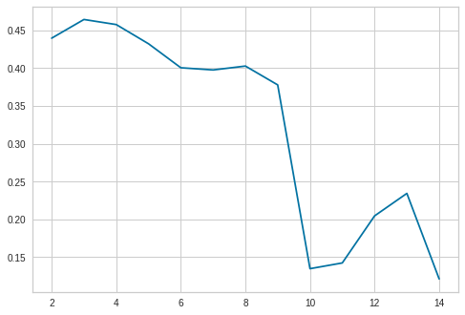
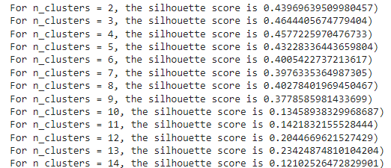
K-Means Clustering: Silhouette Scores
Link to Appendix slide on K-Means Clustering

Slide 34
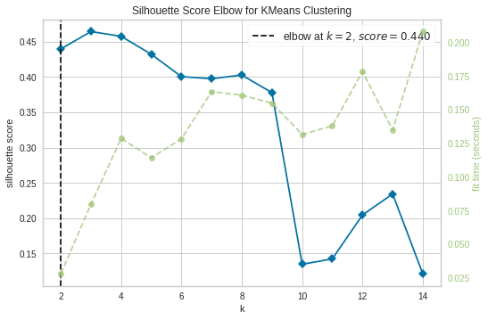
K-Means Clustering: Silhouette Scores (Con’t)
Link to Appendix slide on K-Means Clustering

Slide 35
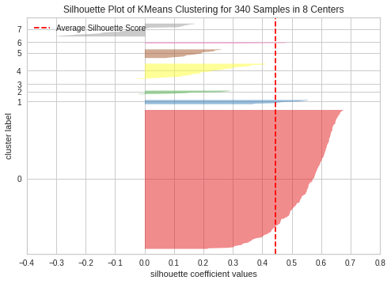
K-Means Clustering: Silhouette Visualizer
Using K=8 we were able to capture the data and realize a significantly large cluster.
Average Silhouette Score is slightly around 0.45
Link to Appendix slide on K-Means Clustering

Slide 36
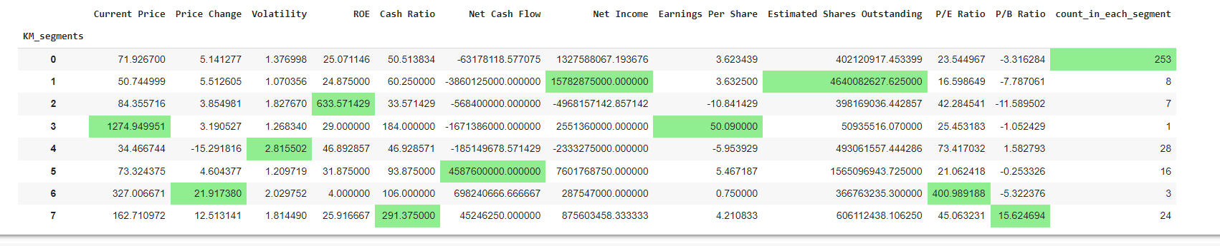
K-Means Clustering: Cluster Profiling
Link to Appendix slide on Hierarchical Clustering

Slide 37
K-Means Clustering: Cluster Profiling (2)
We will take a look at Cluster 2 since it is significantly larger than the other clusters:
Consumer Discretionary 31
Consumer Staples 13
Energy 5
Financials 42
Health Care 27
Industrials 49
Information Technology 19
Materials 16
Real Estate 26
Telecommunications Services 2
Utilities 23
Link to Appendix slide on Hierarchical Clustering

Slide 38
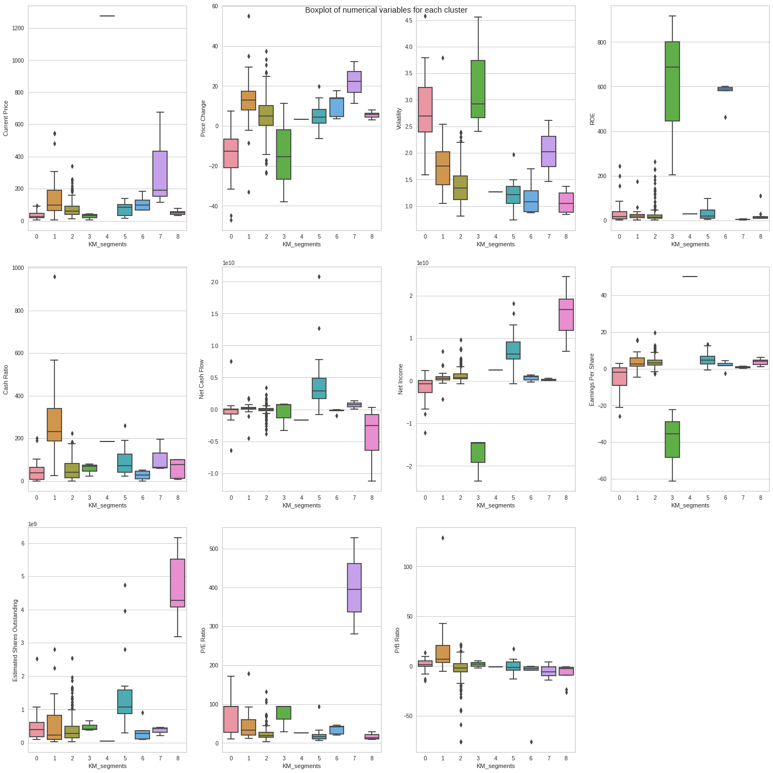
K-Means Clustering: Cluster Profiling
Cluster 7 has the highest current price.
Clusters 0 and 3 appear to be the most volatile.
Cluster 3 has the highest ROE.
Cluster 1 has the highest Cash Ratio.
Cluster 2 has a large set of outliers for the Net Cash flow. Cluster 5 has the best Net Cash Flow.
Cluster 3 has the lowest Earnings per share.
Cluster 7 has the highest P/E Ratio
Cluster 8 has the highest Estimated Shares Outstanding.
Cluster 8 has the highest Net Income.
Link to Appendix slide on Hierarchical Clustering

Slide 39
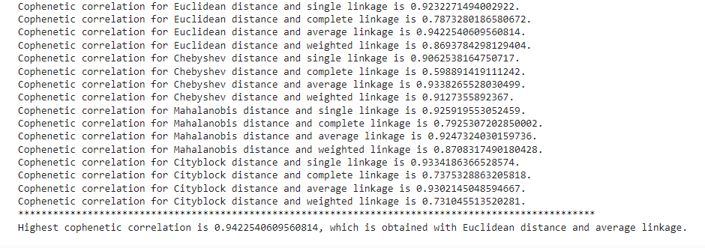
Hierarchical Clustering: Cophentic Correlation
Link to Appendix slide on Hierarchical Clustering

Slide 40
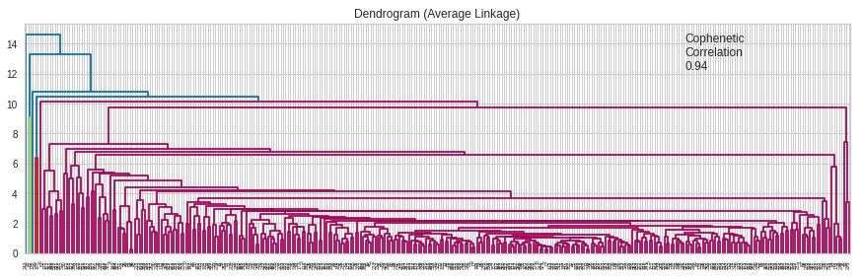
Hierarchical Clustering: Dendogram (Average Linkage)
The following Dendogram displays the Average Linkage after discovering this method scored the highest Cophentic Coefficient. We then stored the values into a dataframe.
Link to Appendix slide on Hierarchical Clustering

Slide 41
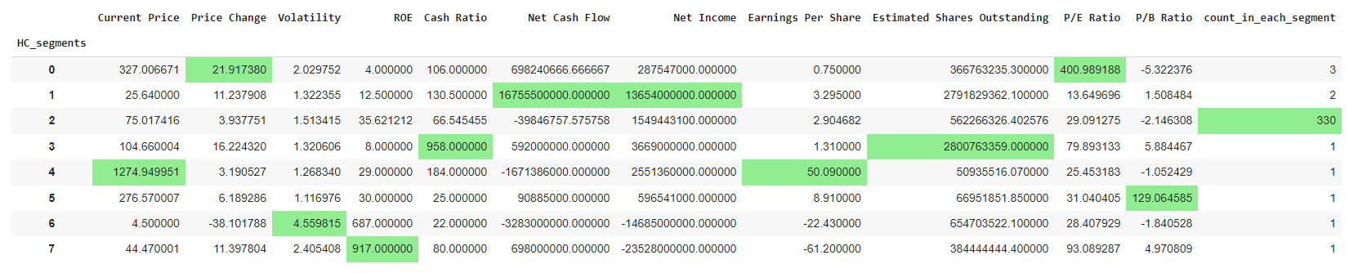
Hierarchical Clustering: Cluster Profiling
Link to Appendix slide on Hierarchical Clustering

Slide 42
Hierarchical Clustering: Cluster Profiling (2)
We will take a look at Cluster 2 since it is significantly larger than the other clusters:
Consumer Discretionary 38
Consumer Staples 19
Energy 28
Financials 48
Health Care 39
Industrials 53
Information Technology 29
Materials 20
Real Estate 27
Telecommunications Services 5
Utilities 24
Link to Appendix slide on Hierarchical Clustering

Slide 43
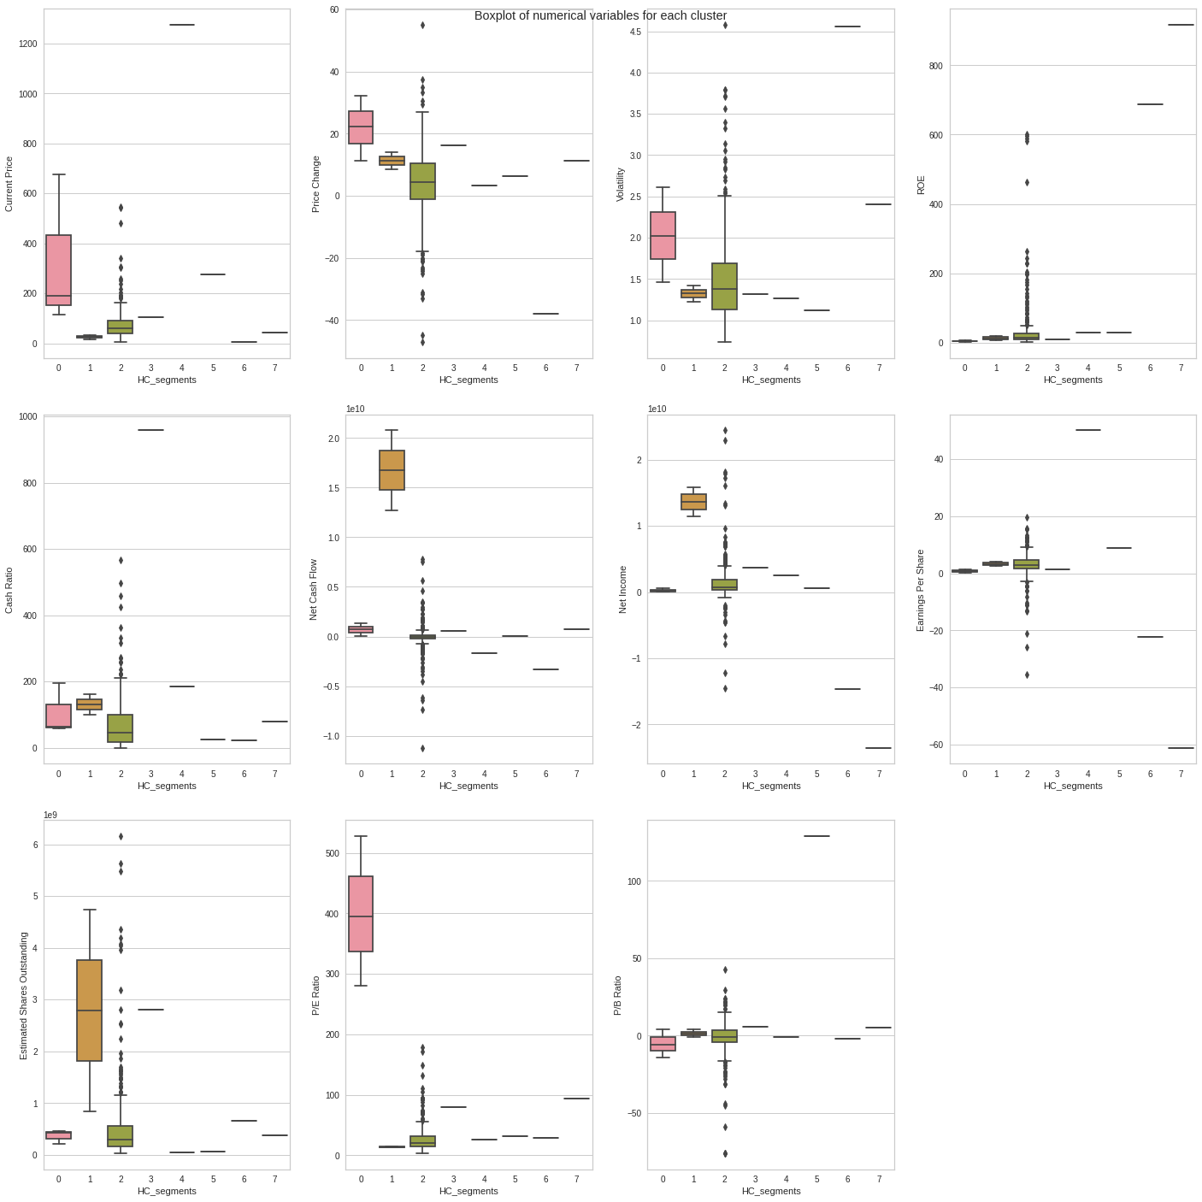
Hierarchical Clustering: Cluster Profiling
Cluster 0 has the highest Current Price.
Cluster 0 has the highest Average Price Change but Cluster 2 has larger outliers.
Cluster 0 has the highest Average Volatility but Cluster 2 has larger outliers.
Cluster 2 has the highest ROE.
Cluster 1 has the highest Net Cash Flow.
Cluster 1 has the highest P/E Ratio.
Cluster 1 has the highest Estimated Shares Outstanding.
Cluster 2 has the highest P/B ratio.
Link to Appendix slide on Hierarchical Clustering

Slide 44
K-Means Clustering vs Hierarchical Clustering
Hierarchical Clustering seemed to group and specifically focus on 3 clusters.
When the Cluster Profiling was done, Cluster 2 seemed to have a slight increase in count. There was a significant increase in Energy count compared to the analysis in K-means.
For Volatility, the hierarchical clustering found Cluster 6 the highest. For K-means, this was Cluster 4.
For Hierarchical Clustering, Cluster 7 displayed the higher ROE compared to K-means which selected Cluster 2.

